Slide 1
Upsilon Meson ϒ

Slide 2
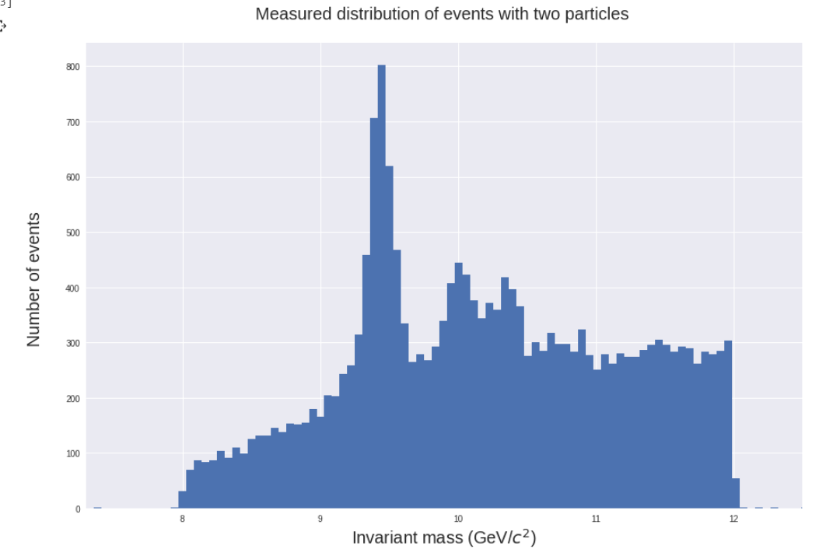
Using data from open data cvs Sample6 obtained from https://goo.gl/5kgxKF We have 20,00 events and we do the reconstruction of the invariant mass using the expression M=2Pt1Pt2(cosh(η1-η2)-cos(ϕ1-ϕ2))

Slide 3
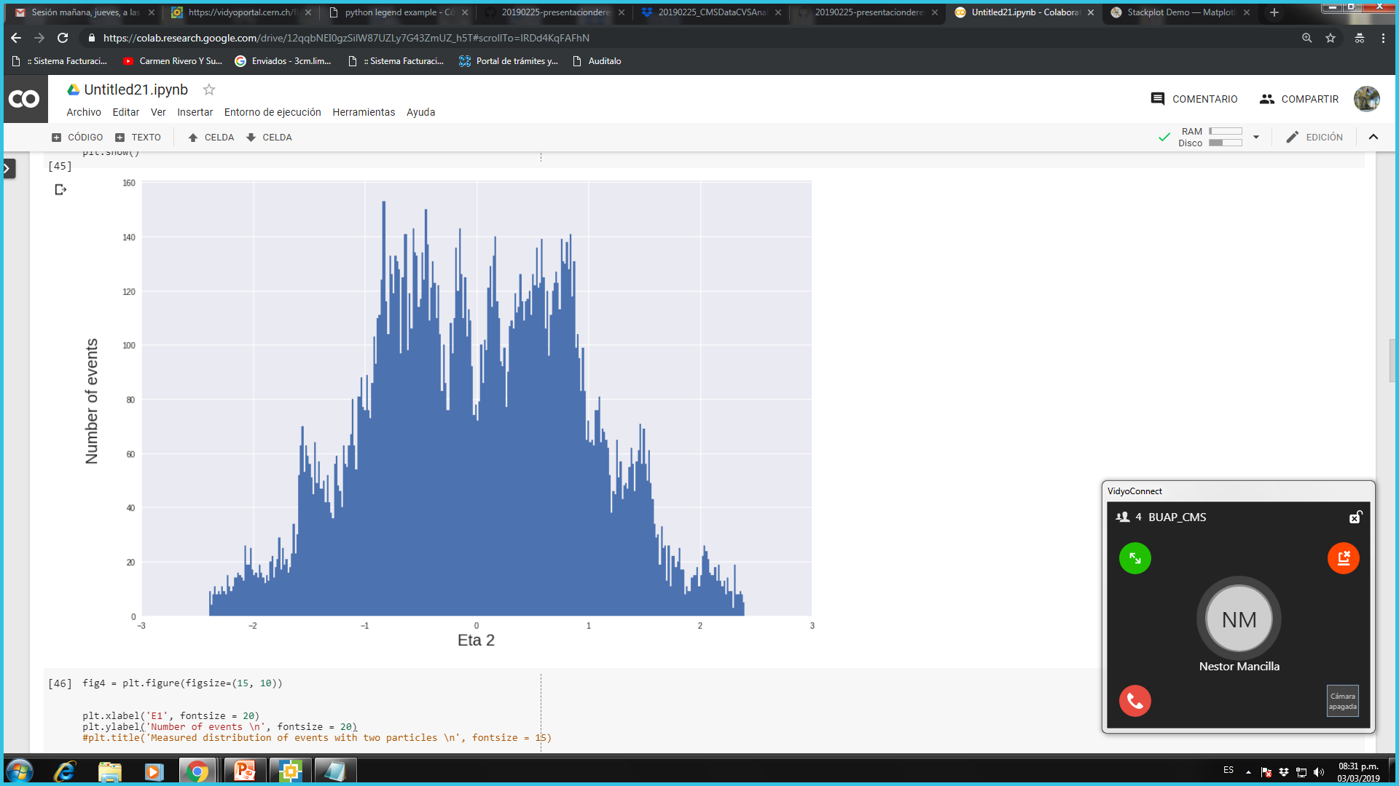
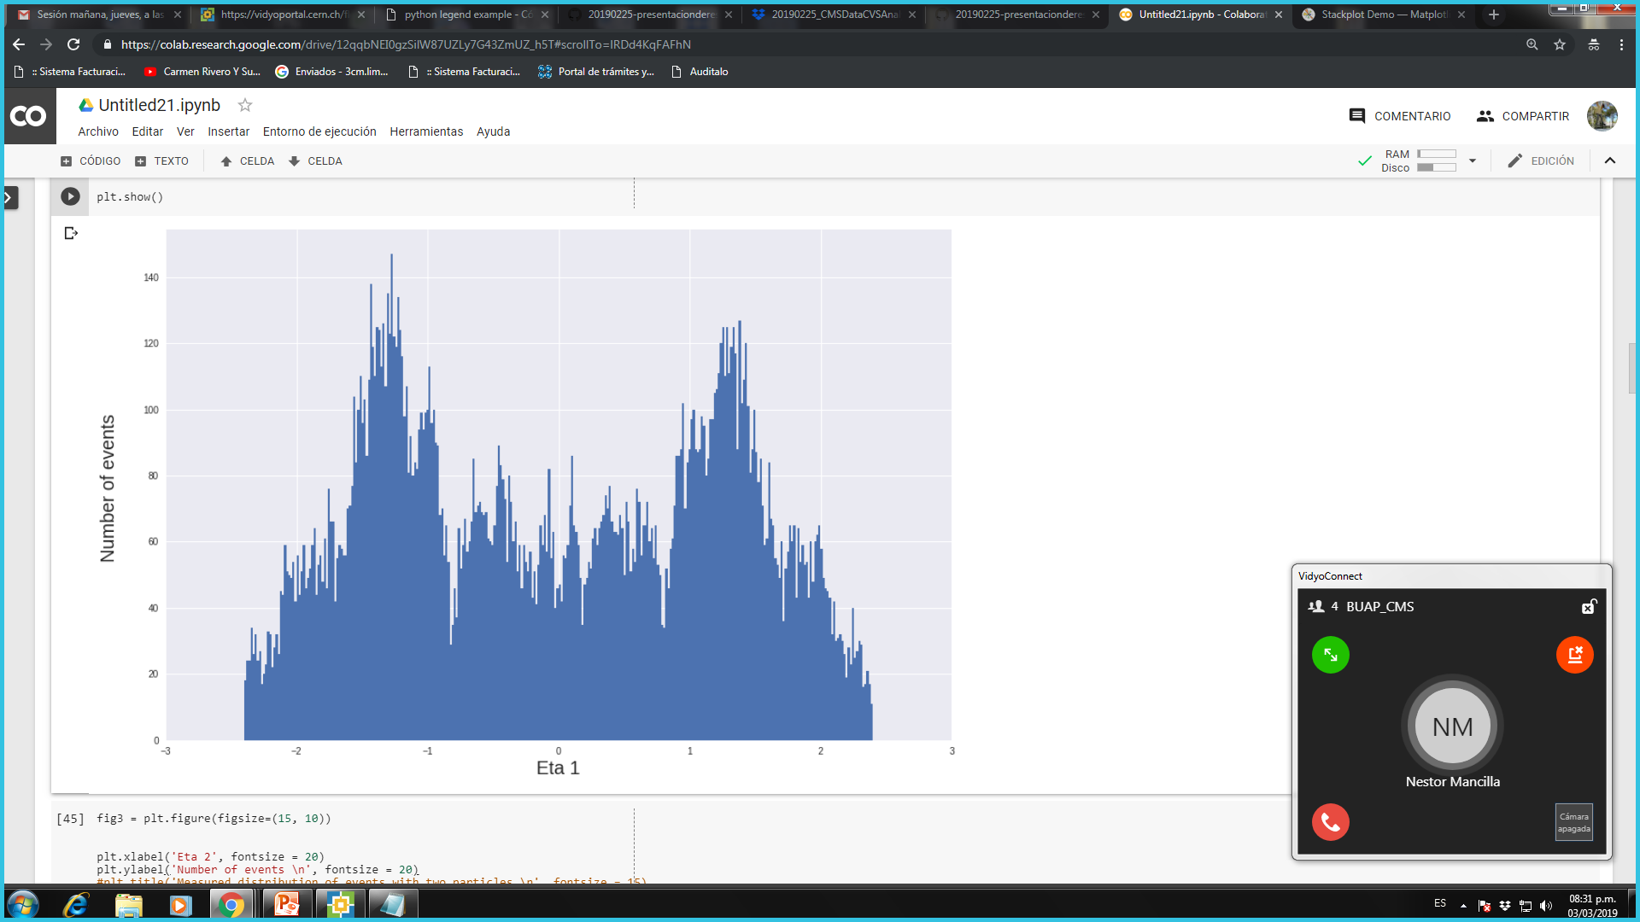
To make the cuts, we consider the variables eta, the energy and the transverse moment.
For eta, we can see that there are spaces in the graph due to the separation between the endcaps and the barrel, so we restrict the cuts to only the areas where there are peaks, therefore, we consider Eta1 in a range between -1.8 to -08. and 0.8 to 1.7, for Eta2 we consider a range between -1 and 1

Slide 4
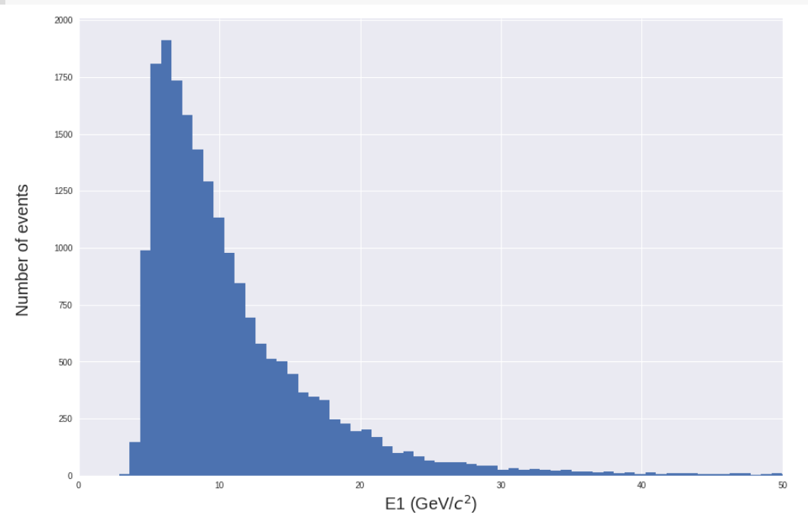
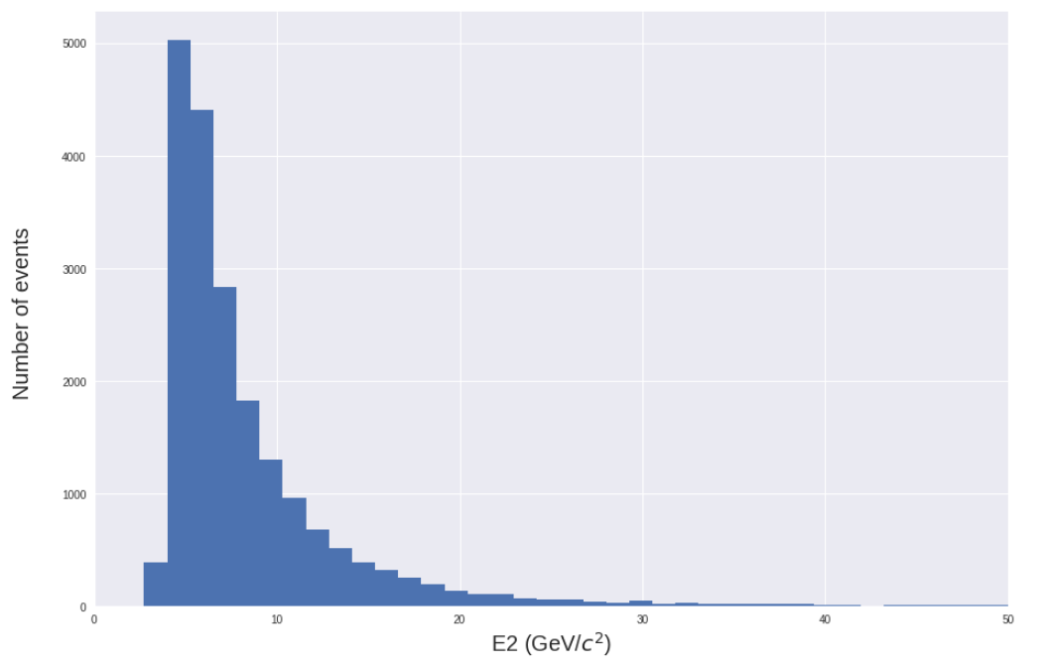
For energy and transverse momentum, we consider the events with the highest energy according to the distributions.
For E1 we will consider the range between 0 and 12 GeV and for E2 between 0 and 10 GeV.

Slide 5
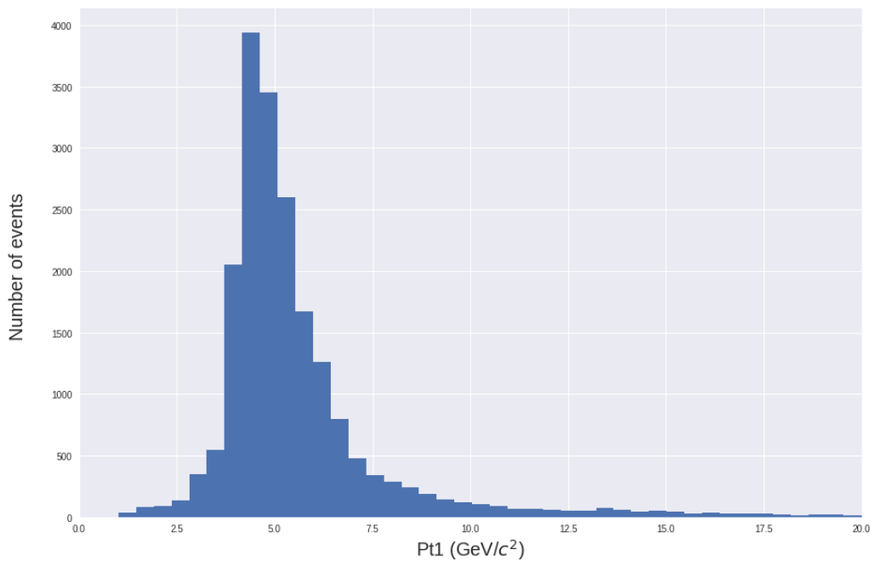
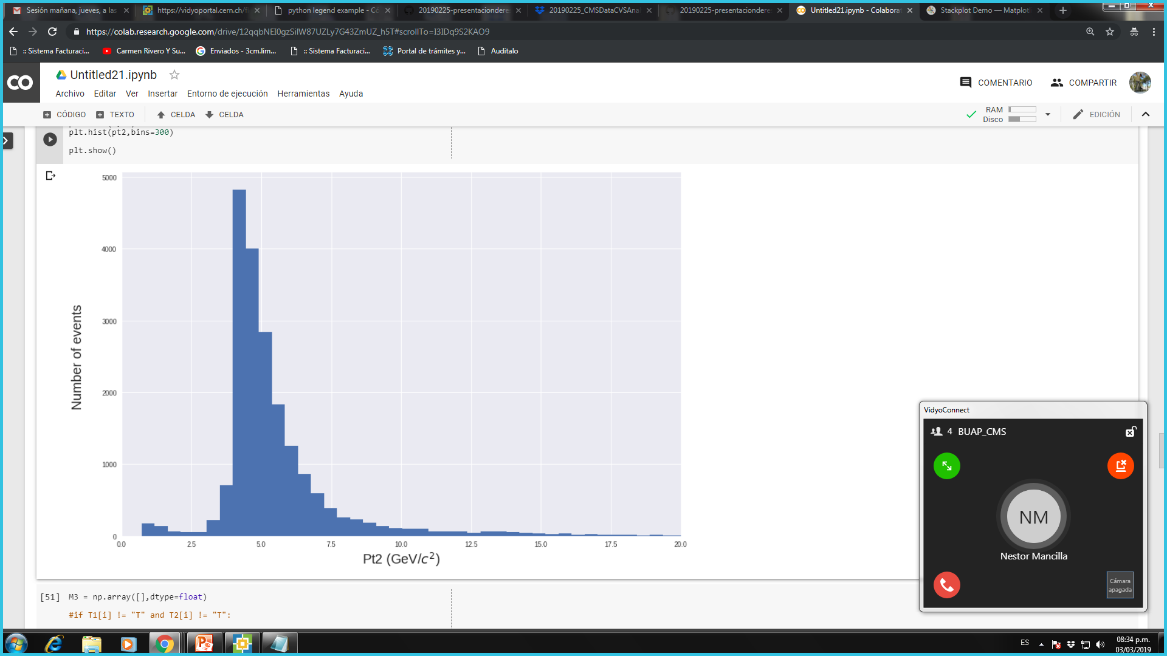
Finally for Pt1 and Pt2 we will consider a range between 3.5 to 6.5.

Slide 6
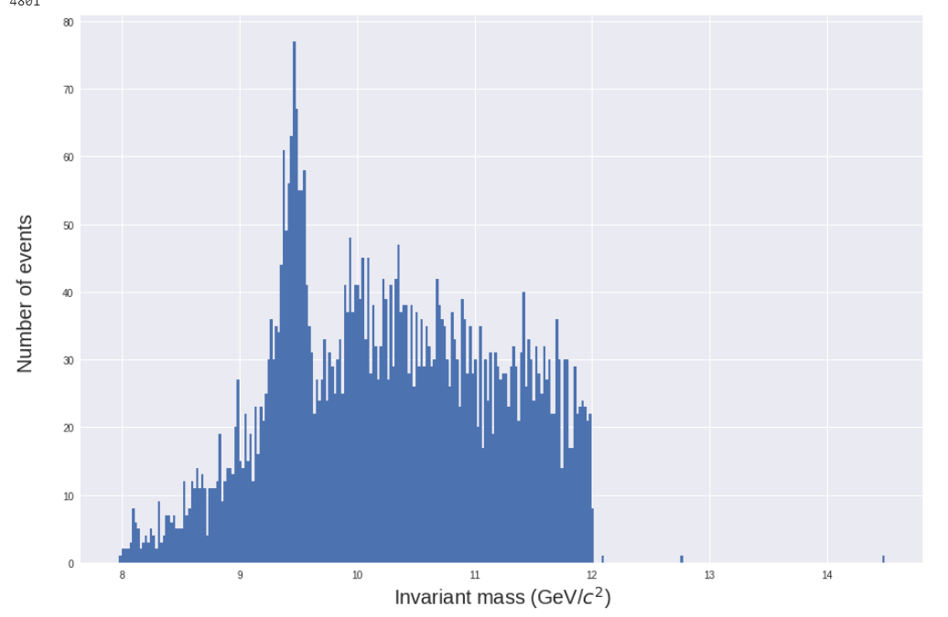
We consider only global muons to do a better reconstruction because the track of the muons are incomplete.
We get only 4801 events, which gives us an efficiency of 24%.
As a result, we obtain a better reconstruction of the invariant mass of the upsilon meson.
M. Tanabashi et al. (Particle Data Group), Phys. Rev. D 98, 030001 (2018) http://pdg.lbl.gov/2018/tables/rpp2018-tab-mesons-b-bbar.pdf

